Slide 1

Project Title-SNAKE GAME
Mini Project Presentation
NAME- AZAM ALI
ROLL NO-2000320130051
Section-A
BRANCH-Information Technology

Slide 2
Contents
Introduction
Requirements of Projects
Design (Flow Chart)
Implementation
Output Screen 1
Output Screen 2
Output Screen 3
Conclusion
Future Plan
coursera Certificate

Slide 3

Introduction
The game called "Snake" or "Snake Game" typically involve the player controlling a line or snake, there is no official version of the game, so gameplay varies. The most common version of the game involves the snake or line eating items which make it longer, with the objective being to avoid running into a border or the snake itself for as long as possible.
The player loses when the snake either runs into a border or its own body. Because of this, the game becomes more difficult as it goes on, due to the growth of the snake

Slide 4
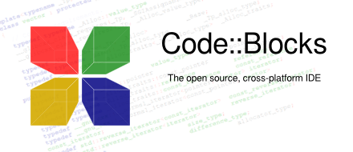

Requirements of Projects
Languages Used-
C Programming
Code::Blocks

Slide 5
Flow Chart
start
end
initial game
piay again?
yes
No
moving
Node incement and Food generated
get food?
yes
game over?
yes
No
No
Again search the food

Slide 6
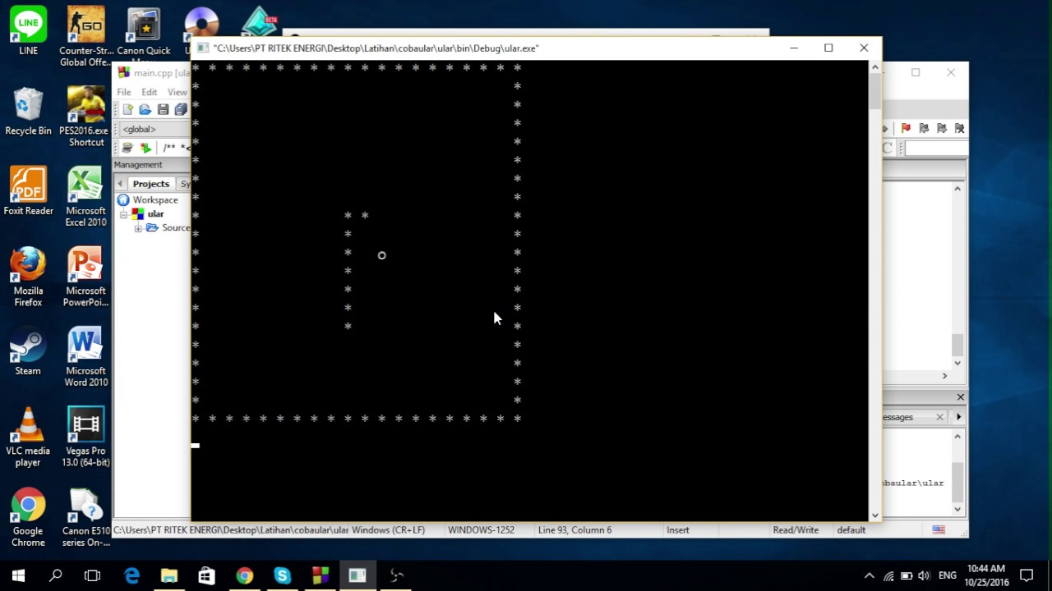

Output Screen...

Slide 7
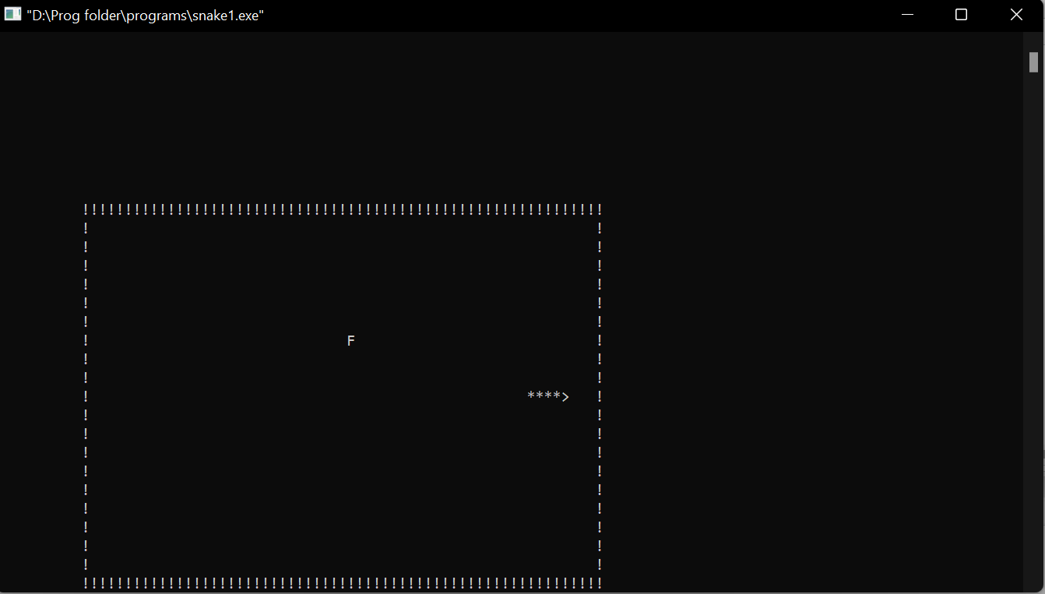
Output Screen...

Slide 8
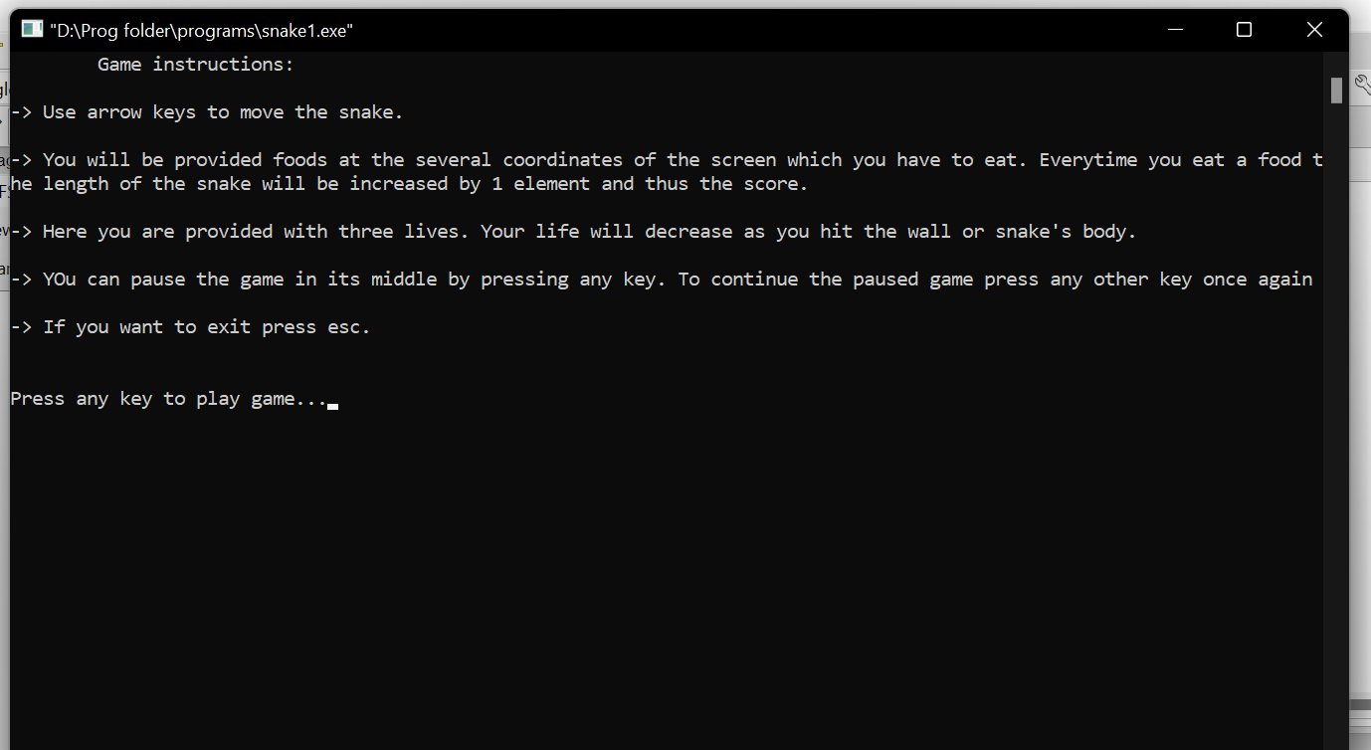
Output Screen...

Slide 9
Conclusion
The object snake position has been set random, so whenever player will start the game, the snake will appear at random location every time and it moves toward the food to eat it.
Players will able to check their result after games get over.
This game is for entertainment.
I am also trying to get perfection in my coding wth the help of this game’s coding.

Slide 10
Future Plan
I would like to add function using c language in future.

Slide 11

Course
I have joined a course on coursera :
The Name of course is :
C for everyone :Programming Fundamentals.

Slide 12
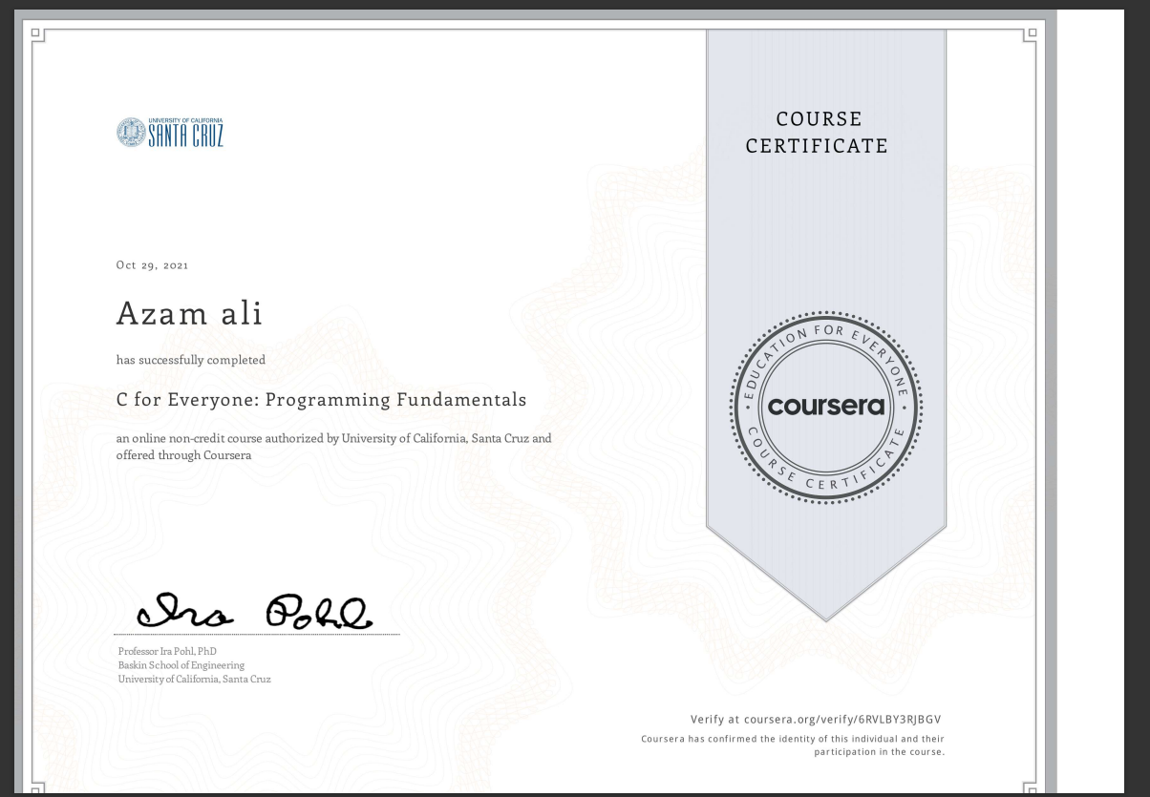
certification

Slide 13
Thank You !

